Slide 1


Android Lecture #6
Event

Slide 2


Index
Event

Slide 3
1. Event
Event type
Event
A user’s interaction with your application
Touch Event
Key Event

Slide 4
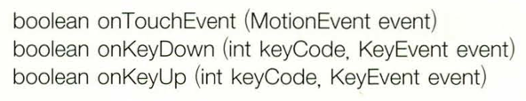
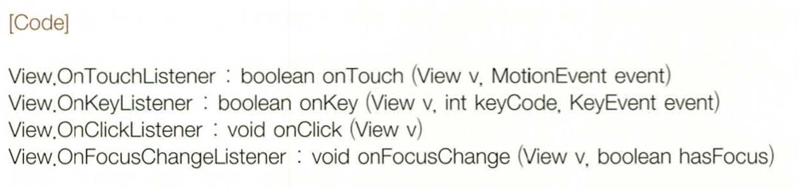
1. Event
Event handling
Using override method
Callback method
Using event
handling object
Event listener

Slide 5
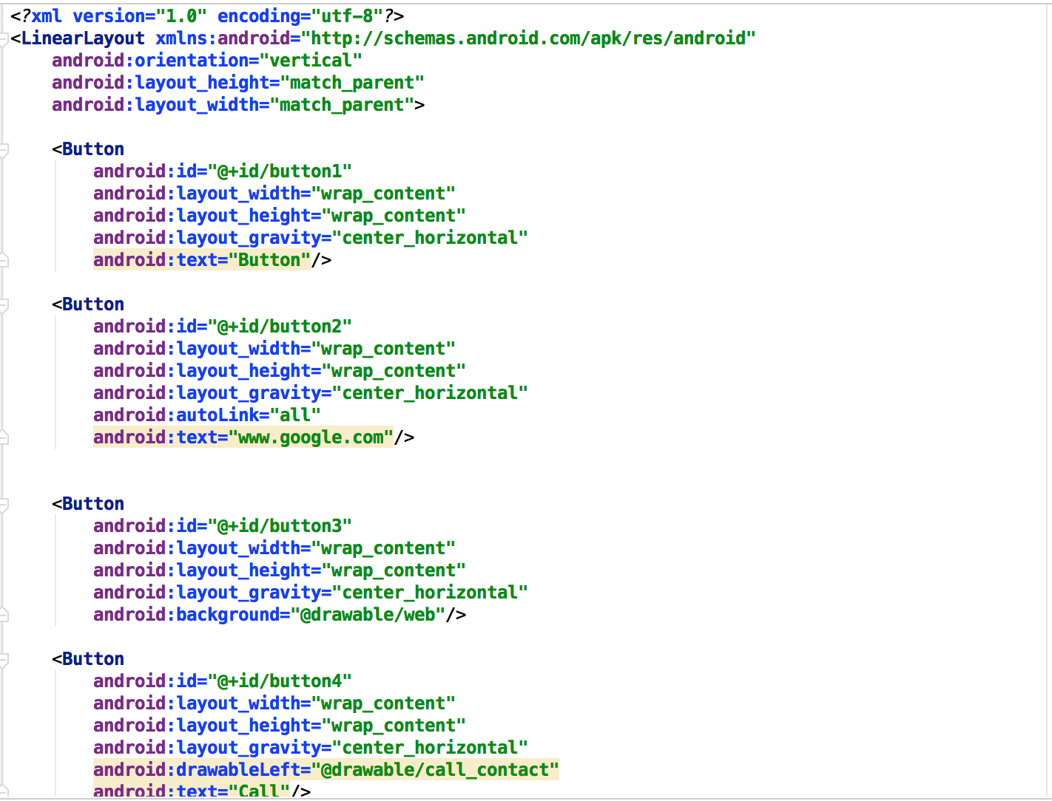
1. Event
Event Source (activity_main.xml)

Slide 6
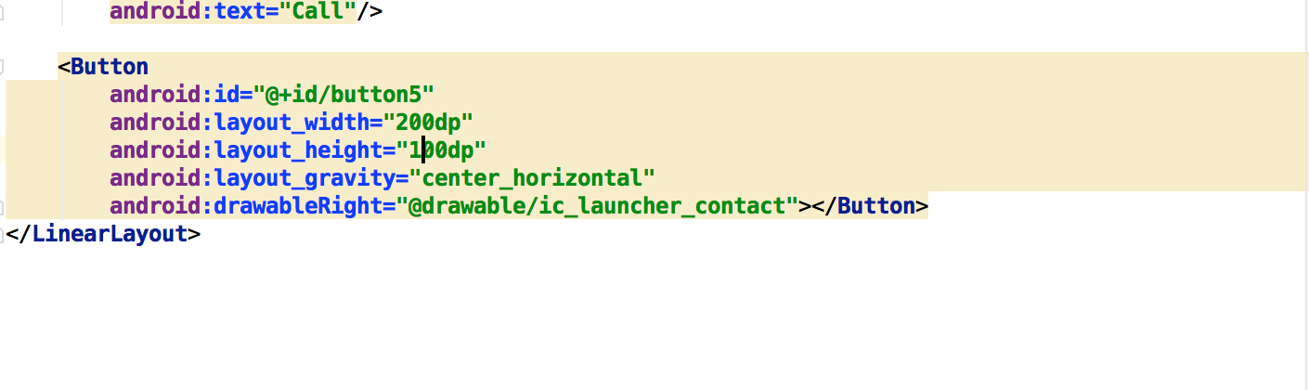
1. Event
Event Source (activity_main.xml)

Slide 7
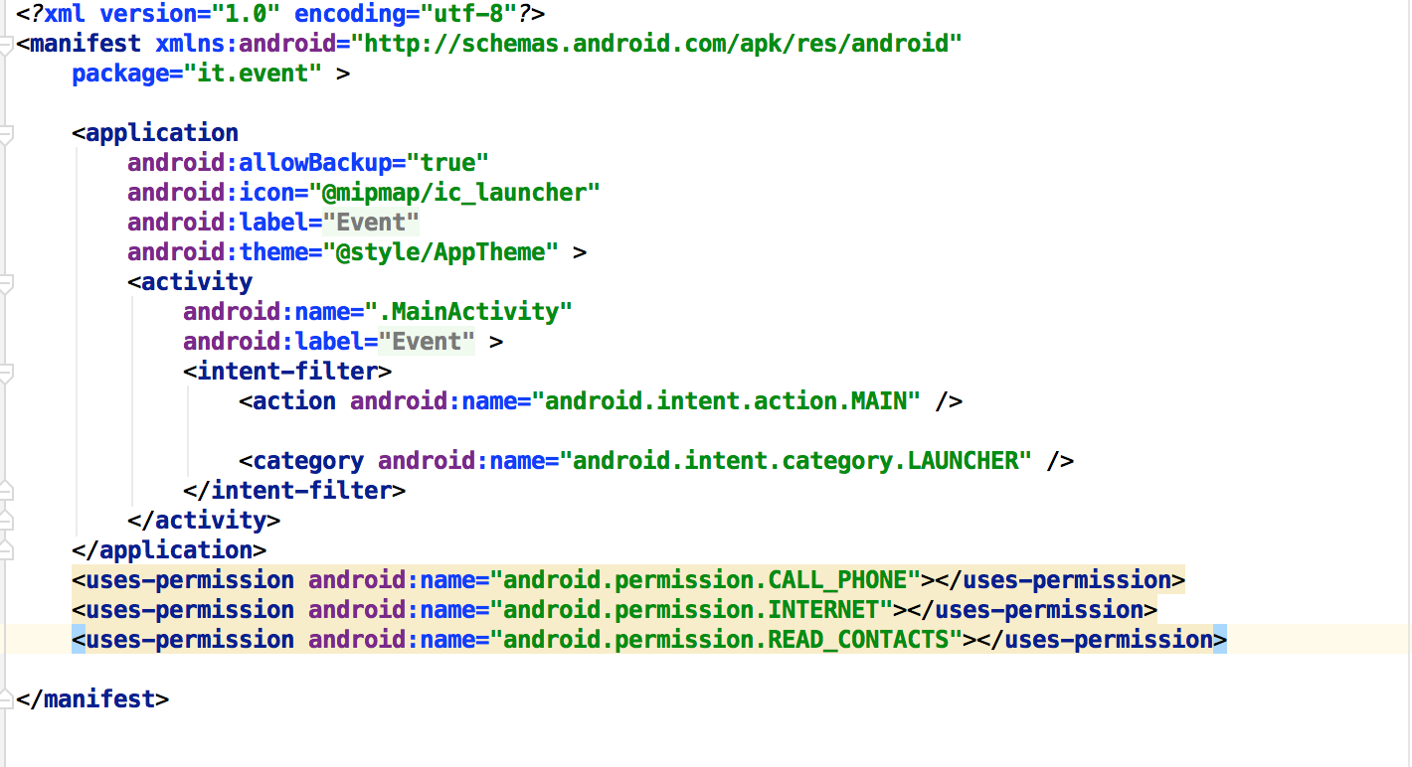
1. Event
Event Source (AndroidManifest.xml)

Slide 8
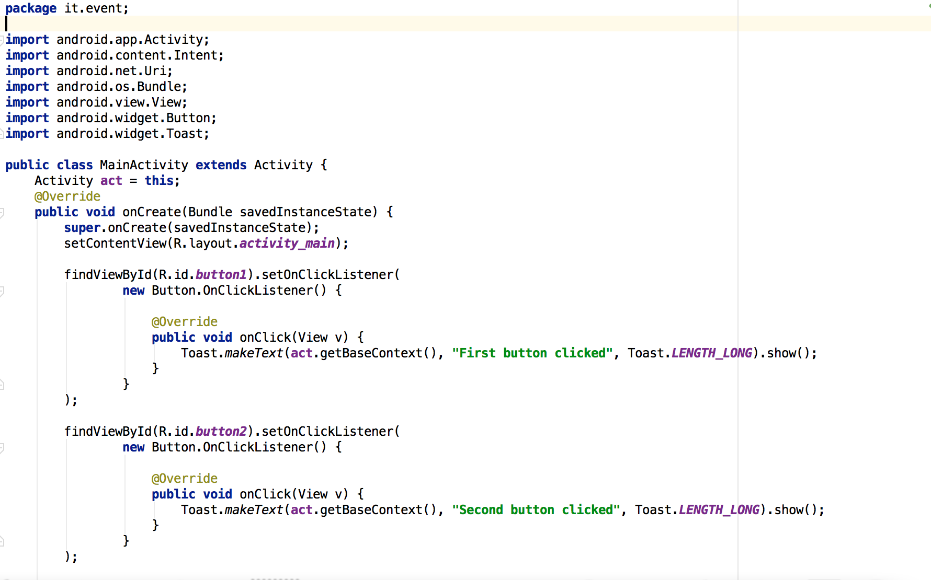
1. Event
Event Source (MainActivity.java)

Slide 9
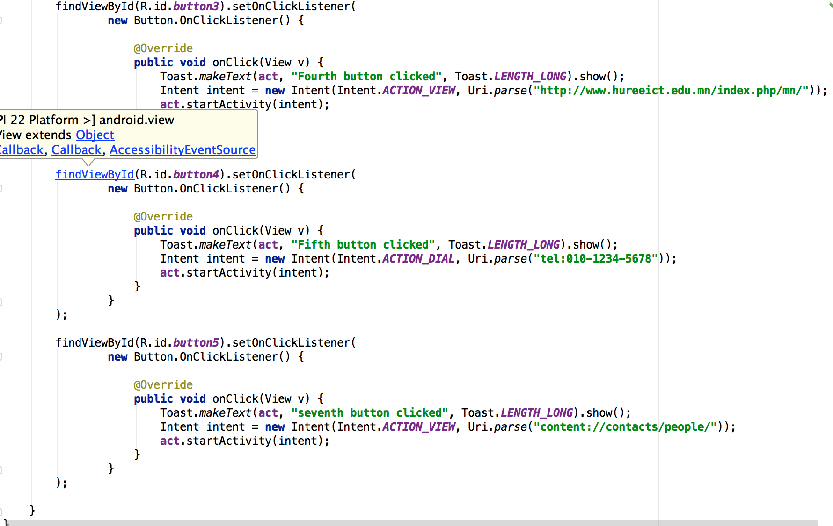
1. Event
Event Source (MainActivity.java)

Slide 10
Thank you!

